Slide 1

New Vehicle Registration Analysis
New Vehicle Registration Analysis
New Vehicle Registration Analysis
Presented by:
Prashansa Thapa
Bikin Ghimire

Slide 2
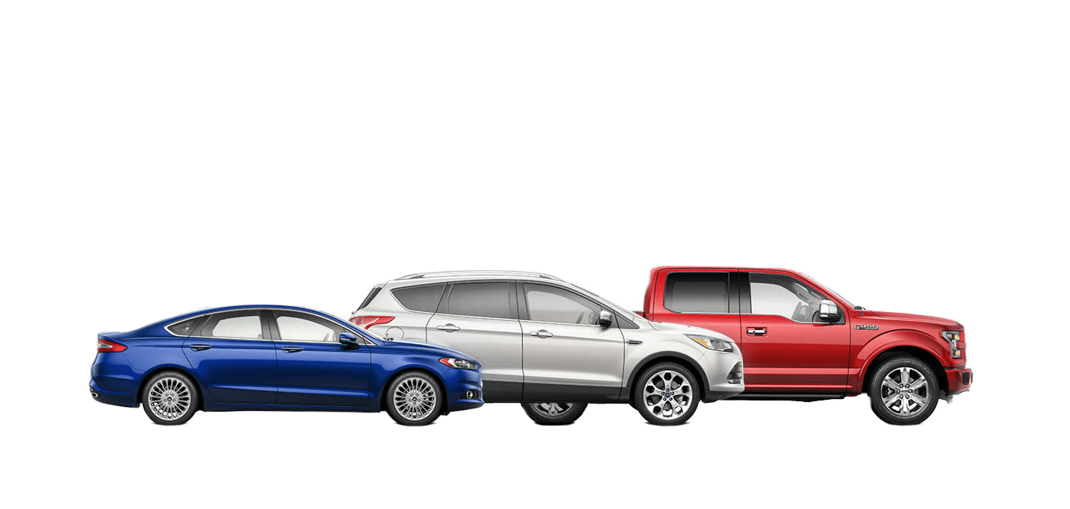
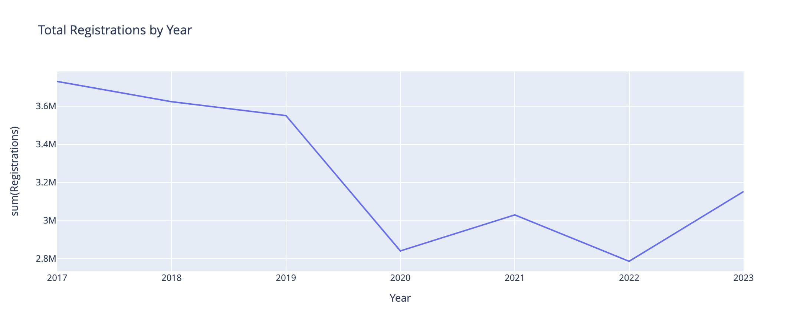
New Vehicle Registration Analysis
New Vehicle Registration Analysis
New Vehicle Registration Analysis
Total Vehicle Registration By Year
3,151,573
New vehicles were registered in Canada in 2023
Notes:
Over 3 million new vehicles were registered in Canada in 2023.
That’s 1 vehicle registration for every 8 person in Canada.
Automobile business is a big contributor of economy in Canada, and therefore, it is very beneficial for them to analyze the trends in vehicle registrations to plan and prepare for future peaks or downfalls in vehicle demands, seasonal trends, and popular categories.
Why is that more important now?

Slide 3
Total Vehicle Registration By Year
Notes:
Although the total registrations has decreased since 2017, but there has been a rise from 2022 to 2023. We could assume that the numbers in registrations will go higher up, as the side-effects of the COVID-19 pandemic slowly dies down.
This is why, we opted to analyze the vehicle registration dataset and provide insights on trends, popularities, and possible forecasting.

Slide 4
Objectives
To help prepare automobile sellers based on popularity and seasonal trends.
Identify what time of the year vehicles purchased the most
Identify the distribution of vehicle registration based on provinces
Identify which vehicle types have sold the most, and which types’ popularity is rising/falling
Identify which fuel type vehicles have sold the most, and which types’ popularity is rising/falling
Forecast the total number of electric type vehicle registration in the next seven seven years

Slide 5
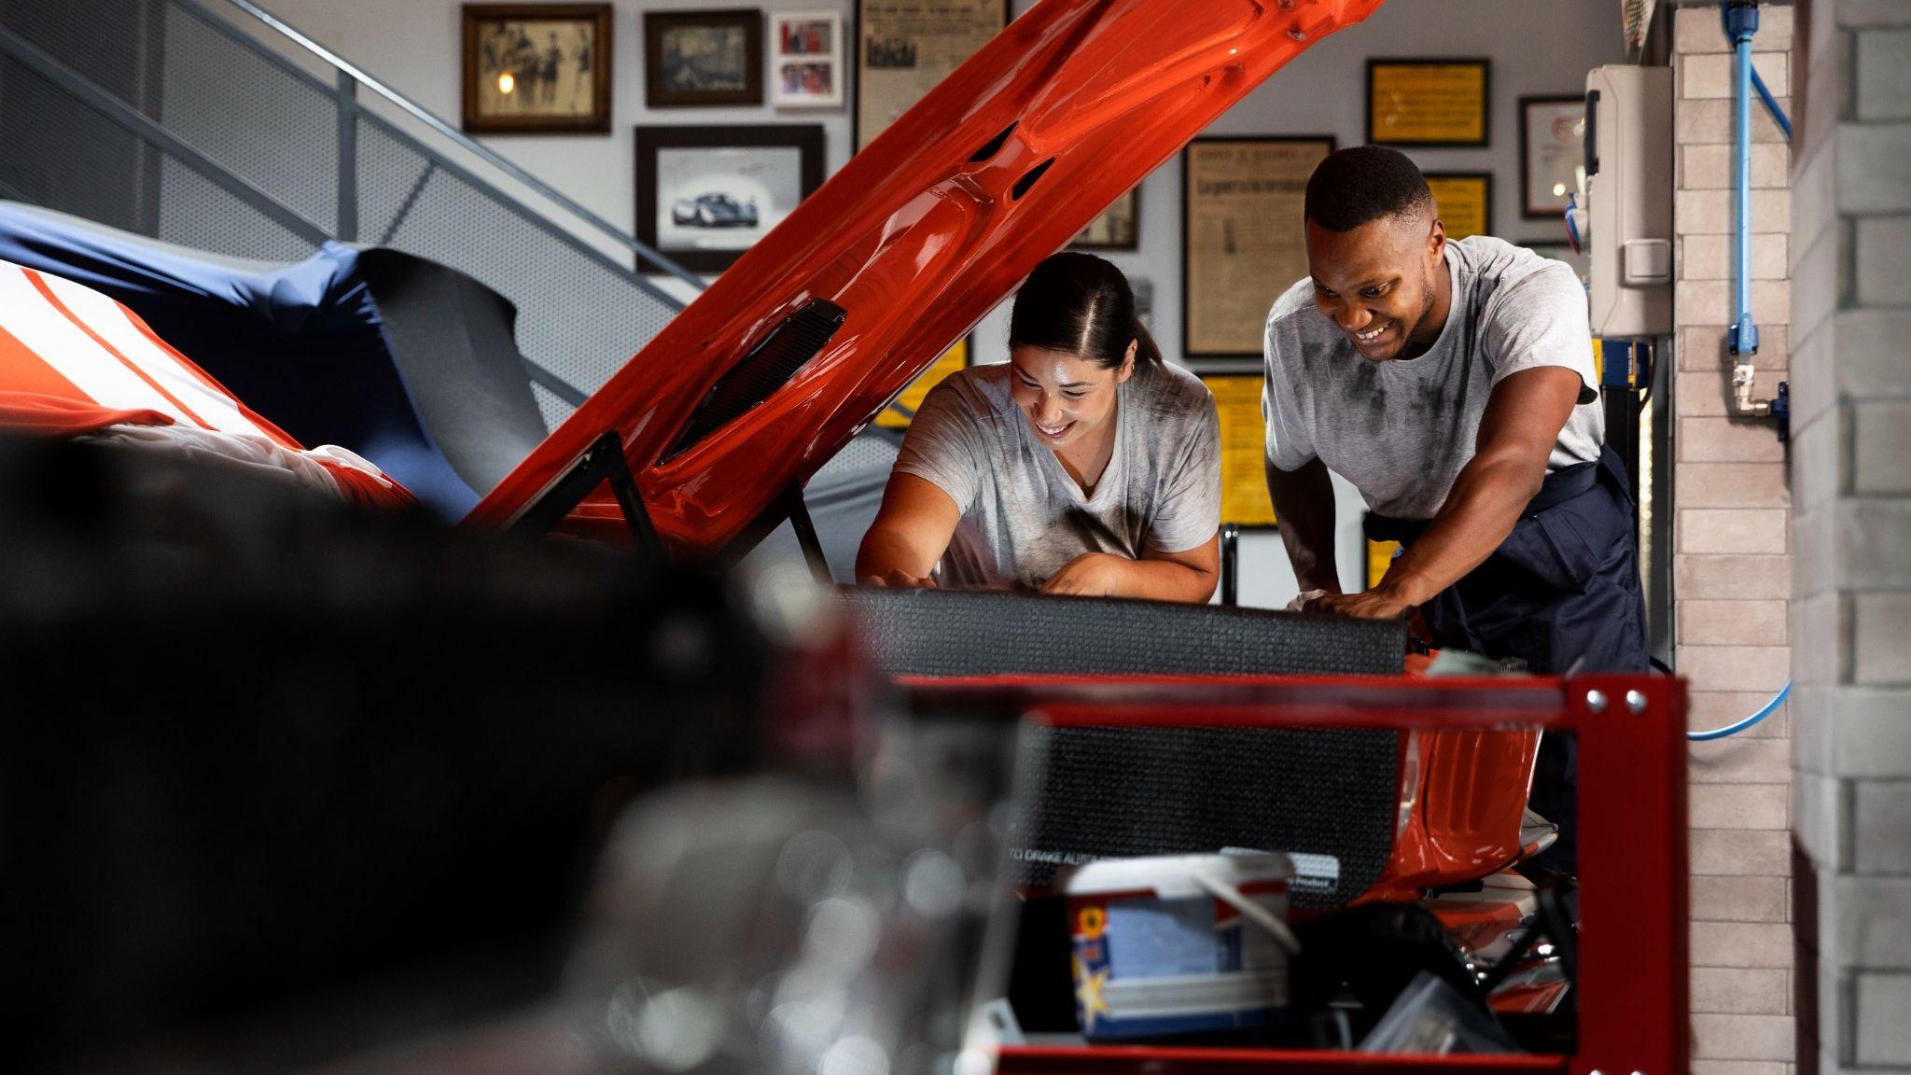
The Process
The Process
02
01
03

Slide 6
The Process
01
02
03
Data Identification
Data Preparation
Data Analysis
Statcan.gc.ca
PySpark
Pandas
Plotly
etc…
Notes:
For our project, finding the right dataset was important. Thankfully, we found the perfect dataset for us from Stats Canada. But, the dataset wasn’t with flaws.
That’s where the second step in the process comes. Cleaning the data. We used the PySpark API to explore and clean our dataset to prepare our data for analysis.
-- Printed the data schema and distinct value of the selected columns only kept the necessary data
And finally, to analyze our data, we used various modules like Pandas, Plotly, and in some special instances Folium and Arima, which we’ll discuss a bit later on.

Slide 7
Data Preparation
What | How
Data Exploration | Viewing distinct rows in each column
Columns | Removed unnecessary columns and added new ones
Null Values | Replaced null with 0 (incase of country sales)
Aggregated rows (Miscalculated) | Removed as correct calculations could easily be made through pyspark
Improper naming/values | Corrected naming/values through regex_replace

Slide 8
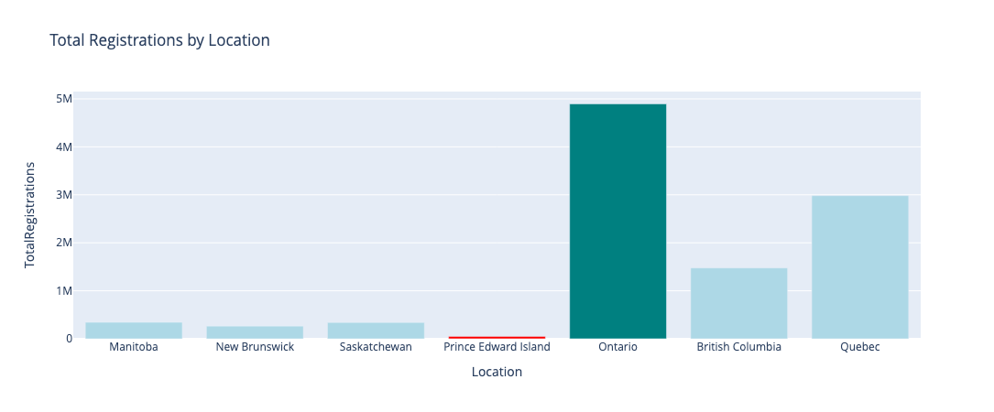
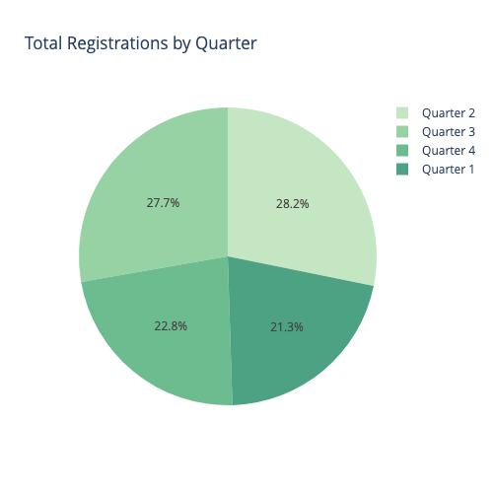
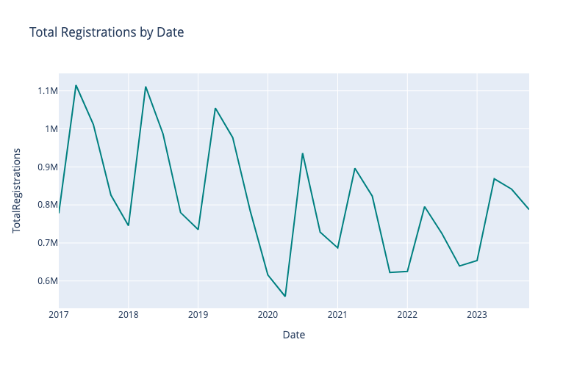
Data Analysis
New vehicle registrations tend to increase in the 2nd quarter and decrease every year,
before it picks up again in the 2nd quarter of the next year.
Notes:
There is a tendency where the vehicle registration spikes every second quarter of each year and decreases by the end of the year. Except for the year 2020
This analysis can help the dealers for example to maintain or prepare their inventory for those peek quarters.

Slide 9
Data Analysis
Ontario has the highest number of vehicle registrations, by far, while Prince Edward Island has the lowest. Data for Newfoundland and Labrador, Nova Scotia and Alberta are currently not available due to contractual limitations of the existing data-sharing agreement.

Slide 10
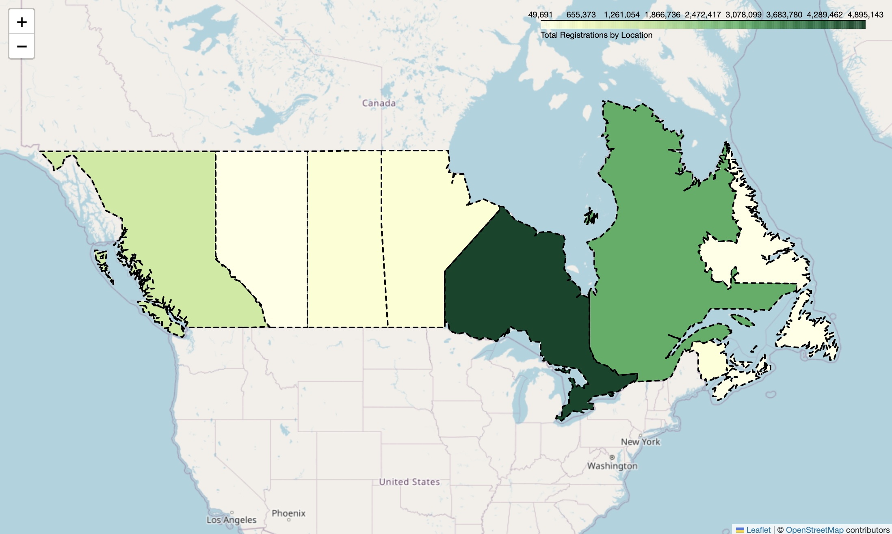
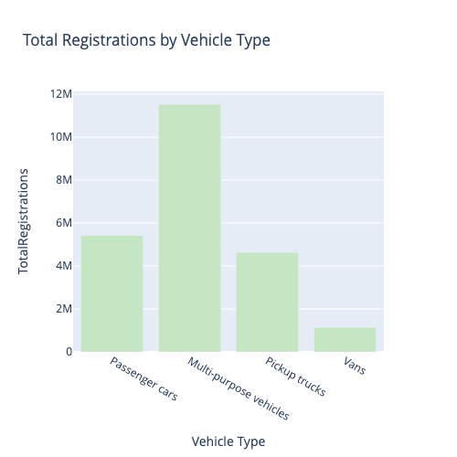
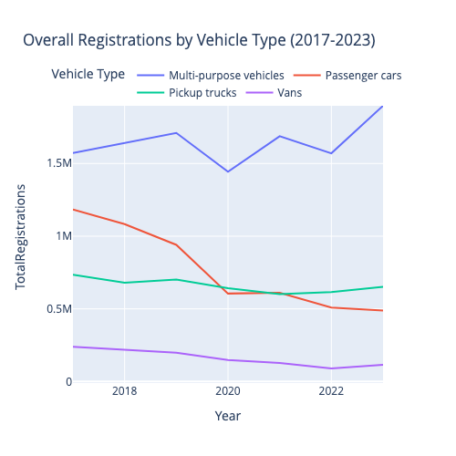
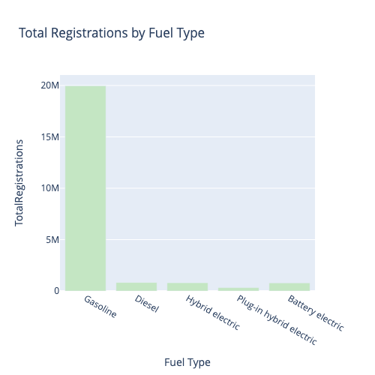
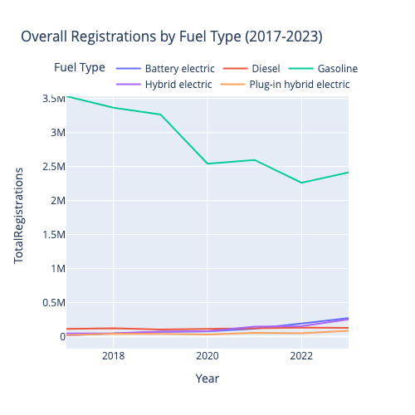
Multi-purpose vehicle is the highest registered vehicle of all types and continues to rise while the registrations of all others have fallen over time.
Data Analysis
Gasoline-type is the highest registered fuel type by a huge margin, but we can see that it’s total registrations has fallen over the years while the registration of Battery electric-type vehicles has increased the most

Slide 11
Data Analysis
Multi-purpose vehicle is the highest registered vehicle of all types and continues to rise while the registrations of all others have fallen over time.
Gasoline-type is the highest registered fuel type by a huge margin, but we can see that it’s total registrations has fallen over the years while the registration of Battery electric-type vehicles has increased the most

Slide 12
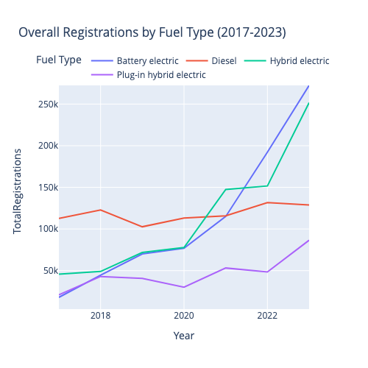
Data Analysis
Multi-purpose vehicle is the highest registered vehicle of all types and continues to rise while the registrations of all others have fallen over time.
Gasoline-type is the highest registered fuel type by a huge margin, but we can see that it’s total registrations has fallen over the years while the registration of Battery electric-type vehicles has increased the most

Slide 13
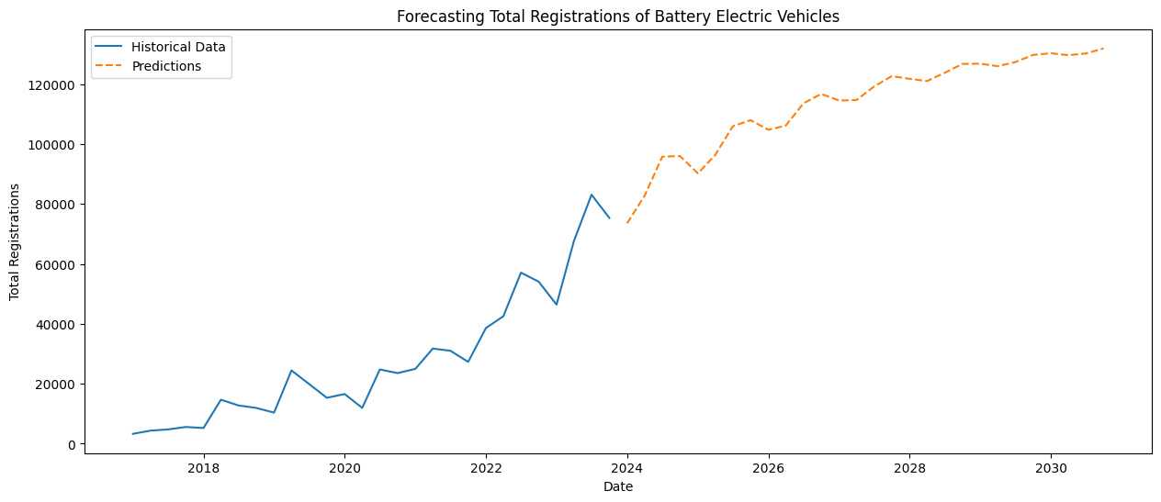
Forecasting
Taking historical data into account, we can forecast a steady rise in the registrations of Battery Electric vehicles in the next seven years.

Slide 14
Conclusion
1 | Quarter 2 followed by Quarter 3 of each year is the best time of the year for targeted sales as registrations is highest during those times.
2 | Ontario, followed by Quebec and British Columbia are the largest market for new vehicle registrations.
3 | Multi-purposed vehicles (SUV and larger) are the most popular among people, and continues to be more popular. In contrast, passenger vehicles (Sedan and smaller) are becoming less popular among the people.
4 | While gasoline using vehicles is, by far, the most popular among people, it’s registrations have been decreasing over the years, while vehicles operating via battery are becoming more popular.
5 | Via forecasting, we know that the registration of Battery Electric vehicles is expected to rise quite a lot in the upcoming years, so vehicle sellers should focus on stocking these types of vehicles more.

Slide 15
Challenges and Limitations
Learning Curve
Learning to use new modules and data analysis techniques
Data Categories
Diverse categories in the dataset would help make more useful analyses.
Forecasting Accuracy
Forecasting could have been done in a much more accurate way
Time Management
Could have managed time better for more outputs

Slide 16
Tools and Techniques Used
Code Editor and Development Environment | VSCode, Jupyter Notebook, Python
Data Extraction and Transformation | PySpark
Data Analysis | Numpy, PySpark, Pandas
Predictive Analysis | ARIMA model
Visualization | Plotly, MatPlotLib, GeoJson & Folium (For GeoMap)

Slide 17
Thanks
Does anyone have any questions?

